Slide 1

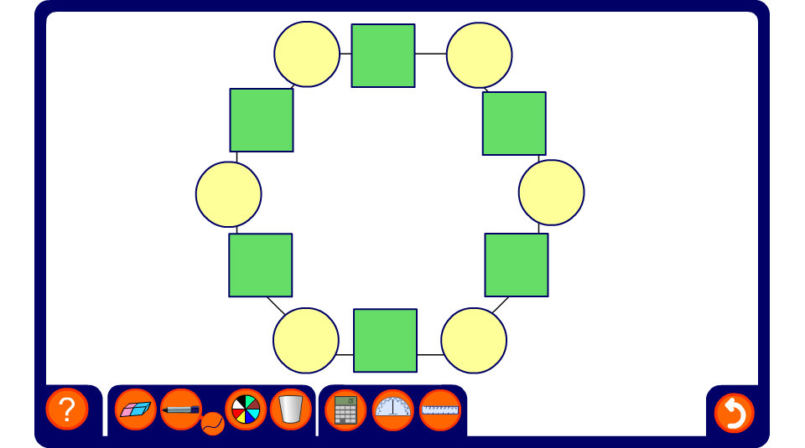


Hexagon puzzle
Notes:
The numbers in the squares are found by multiplying the terms in the circles on either side.
Reveal each term until the puzzle is complete. The order can be modified to practice both multiplication and division of indices.
Discuss briefly the fact that when we multiply two terms together with the same base (the letter n, in this case) we add the powers. When we divide two terms with the same base (the letter n) we subtract the powers.

